Slide 1
Perspective Warping
CSCI 4150/6050: Computer Vision

Slide 2
Perpective Warping

Slide 3
Perpective Warping
You’ve already seen how to perform transformations on an image, but they all existed in 2D plane.
Perspective projection is from any 3D plane to any other 3D plane

Slide 4
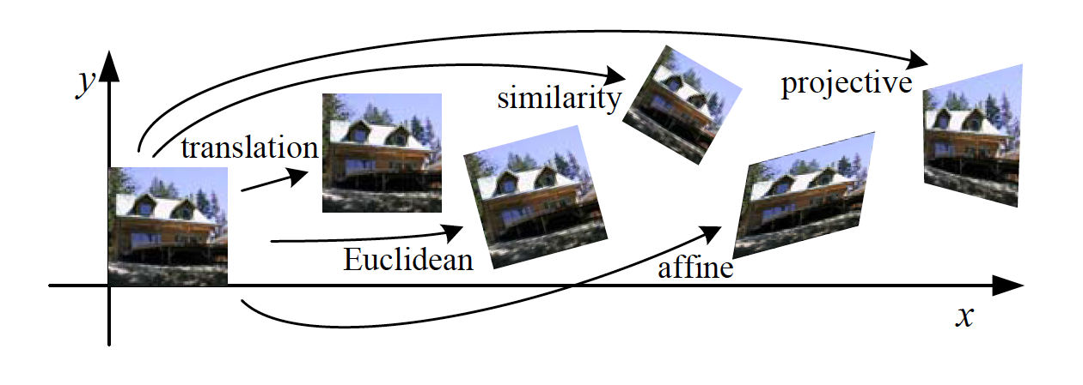
Classes of Transformations

Slide 5
“Straight On” View

Slide 6
“Birds-Eye” View

Slide 7

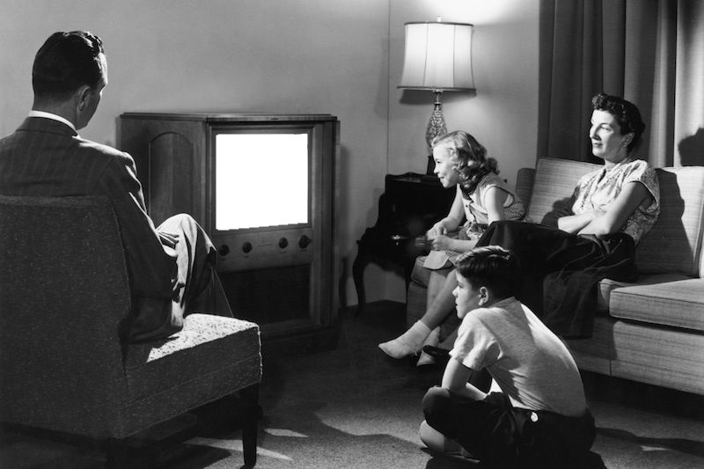

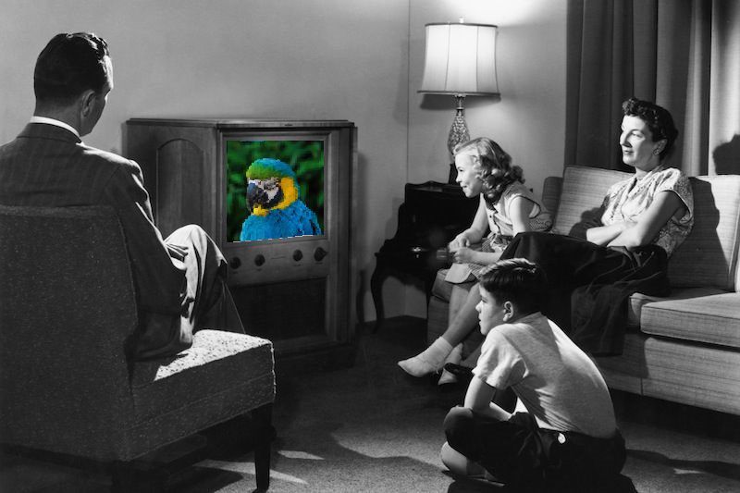
Or Going The Other Way

Slide 8
Let’s see it in Photoshop…

Slide 9

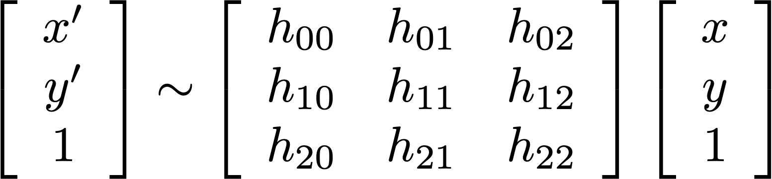
Homographies
Perspective projection from a plane to another plane is a homography
Same 3 x 3 matrix transformation you’ve seen before, but the bottom row doesn’t have to be [0 0 1]
In practice, it’s invertible!

Slide 10
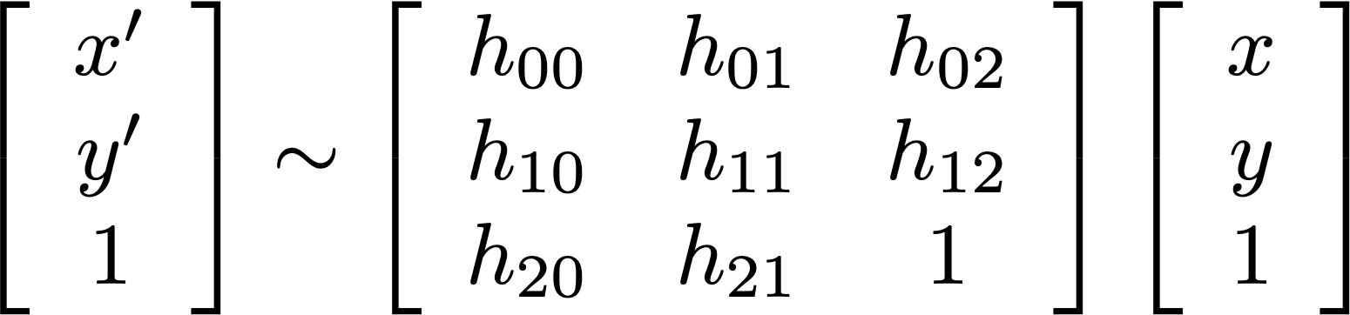
Homographies
Non-zero multiple of a homography does the same transformation
That means there are really only 8 free parameters, not 9

Slide 11
Multiple Pictures of the Same Plane
If two cameras take pictures of a plane from different viewpoints,
  The projection of the plane to each camera is a homography
  The transformation of points from one picture to the other is also a homography!

Slide 12
Computing Homographies
Eight free parameters
A pair of matching points provides two constraints (one for x, one for y)
Four points provides eight equations to solve for eight unknowns
Called the 4-point algorithm

Slide 13

Computing Homographies
Can compute analytically if you know
  Relative positions of cameras (T)
  Relative orientations of cameras (R)
  Camera parameters (K)
  Orientation of the observed plane
  (its surface normal n)
  Distance to the observed plane (d)
Problem: you may not know all these
What if you just have the two images?

Slide 14
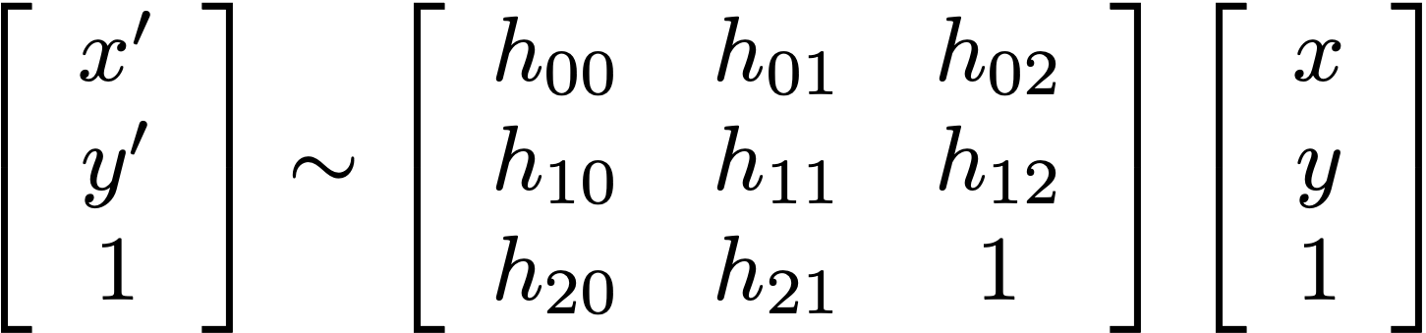

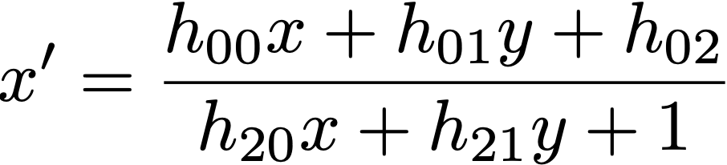
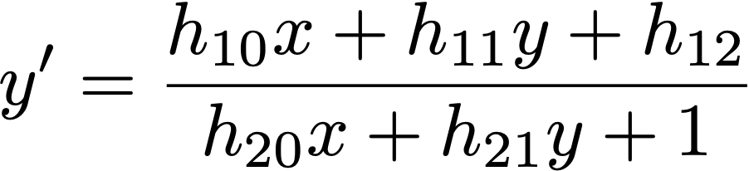
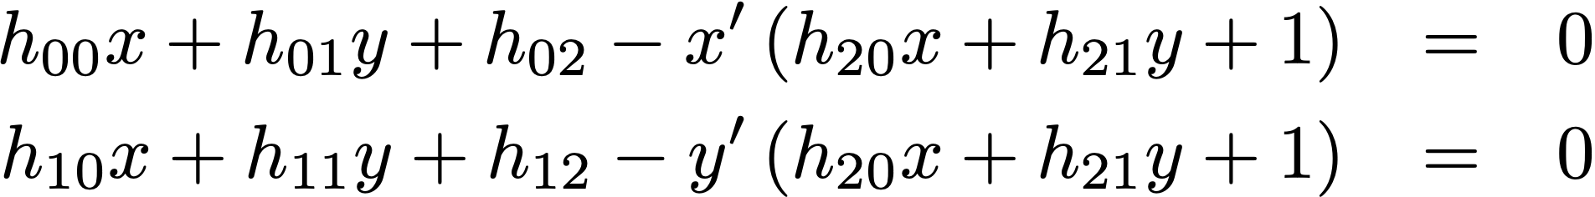
Computing Homographies

Slide 15
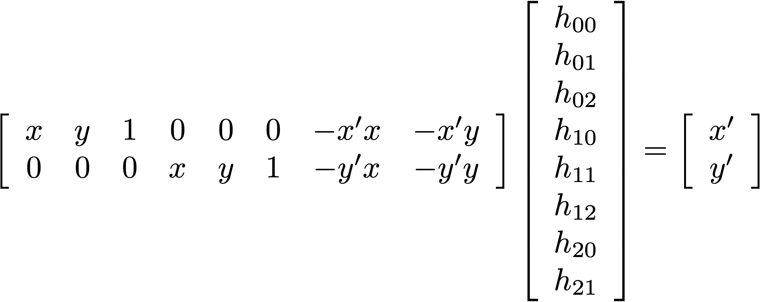
Computing Homographies

Slide 16
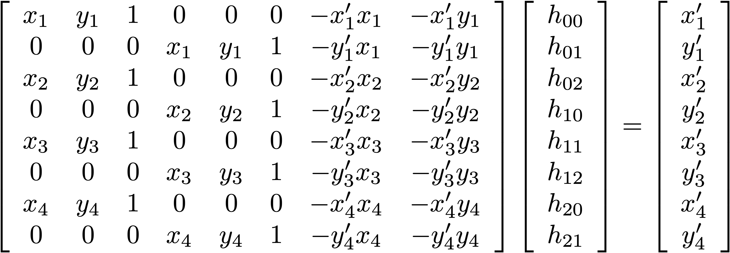
The Four-Point Algorithm

Slide 17

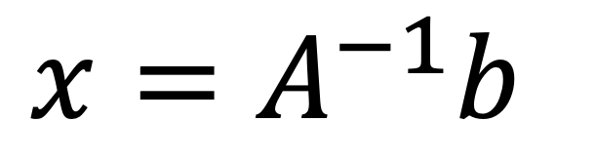

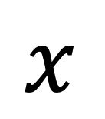
The Four-Point Algorithm
$$A$$
$$x$$
$$b$$
$x=A^{−1}b$
Don’t worry, this is all implemented for you!

Slide 18
Let’s see it in NumPy…

Slide 19
Aside: N-Point Algorithms
Computer vision often requires calibrating parameters between multiple cameras, images, etc.
These calibrations can have many unknowns, and you need the same number of points as there are unknowns.
The four-point algorithm can be expanded to any number of points.
Example: Calibrating two cameras with 5 unknowns each will require 5 known points in each image.

Slide 20
Caution: Avoid Co-Linear Points
Solution fails if any 3 of the 4 points are co-linear
(the matrix in the 4-point algorithm becomes singular)
Don’t even get close to co-linear!
(badly conditioned)
Good:
Bad:

Slide 21
The Homogenous Divide
What does this symbol mean?

Slide 22
The Homogenous Divide
Multiplying by a full 3 x 3 transformation matrix no longer guarantees a that 1 will remain in the homogenous coordinate.
In other words, a homography transformation will give us a 3D point that is usually not on the image plane.
To solve this, reproject the point back to the image plane by dividing by the homogenous value.

Slide 23
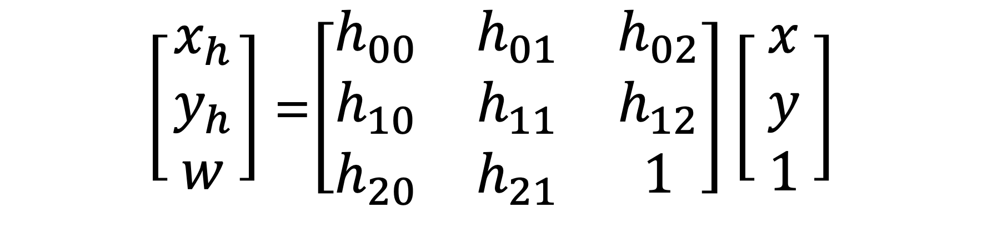
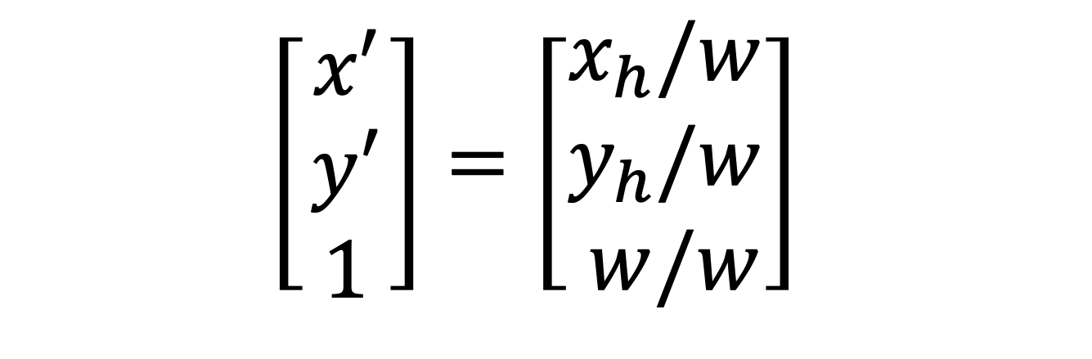
The Homogenous Divide
=
$$\left[\begin{matrix}x′ \\ y′ \\ 1 \end{matrix}\right]=\left[\begin{matrix}x_{h}/w \\ y_{h}/w \\ w/w\end{matrix}\right]$$
$\left[\begin{matrix}x_{h} \\ y_{h} \\ w \end{matrix}\right]$=$\left[\begin{matrix}h_{00} & h_{01} & h_{02} \\ h_{10} & h_{11} & h_{12} \\ h_{20} & h_{21} & 1\end{matrix}\right]\left[\begin{matrix}x \\ y \\ 1 \end{matrix}\right]$
Homogenous Divide

Slide 24

Lab 4

Slide 25
More Applications of Perspective Warping
Image Stitching
Texture Mapping
Warping Meshes
Correcting Distortion
QR Codes

Slide 26
Image Stitching
We will implement this later!

Slide 27
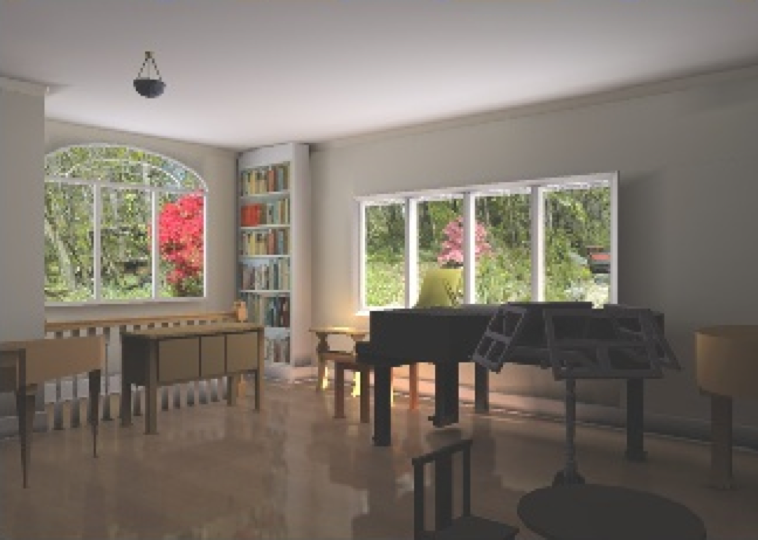
Texture Mapping
Mapping an image onto the surface of a geometric model
Increased realism
Requires warping image onto the object surface
More on this the computer graphics course!

Slide 28
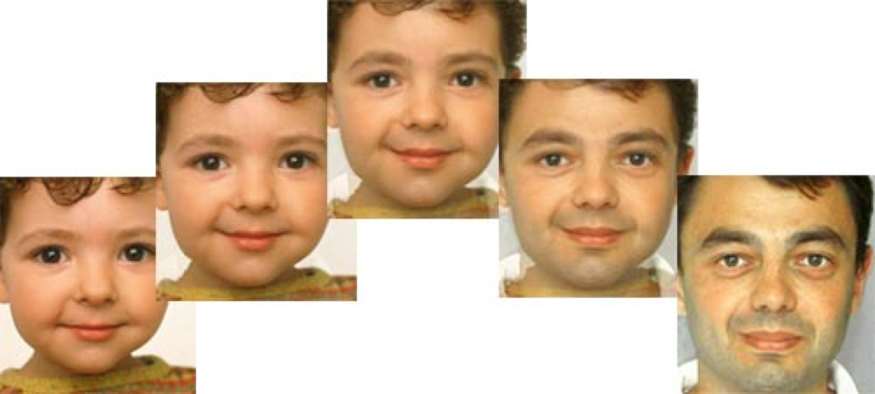
Image Morphing
Warp a pair of images based on corresponding points
Combination of warp/cross-dissolve

Slide 29
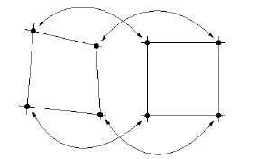
Warp Meshes
Break source/destination images into meshes of quadrilaterals
Map between corresponding “tiepoints”

Slide 30
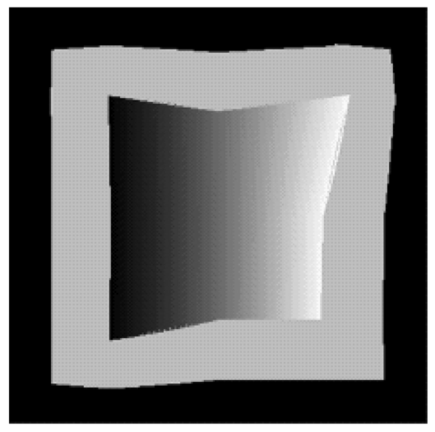
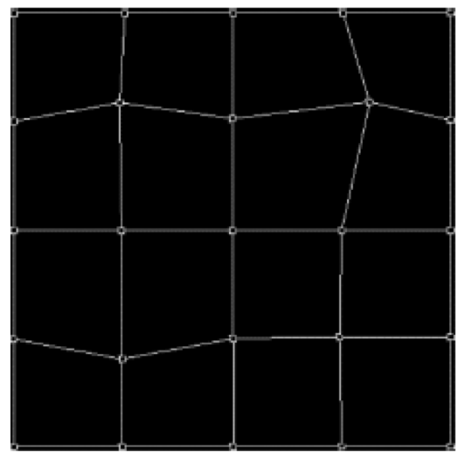
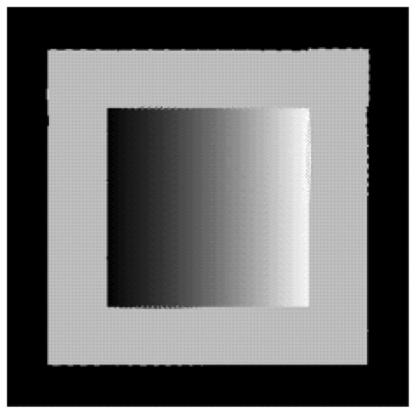
Correcting Distortion
Distorted
source
Overlaying
source mesh
Restored
result

Slide 31
Let’s see it in Photoshop…

Slide 32

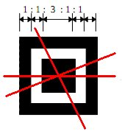
QR Codes: Finding Corners

Slide 33
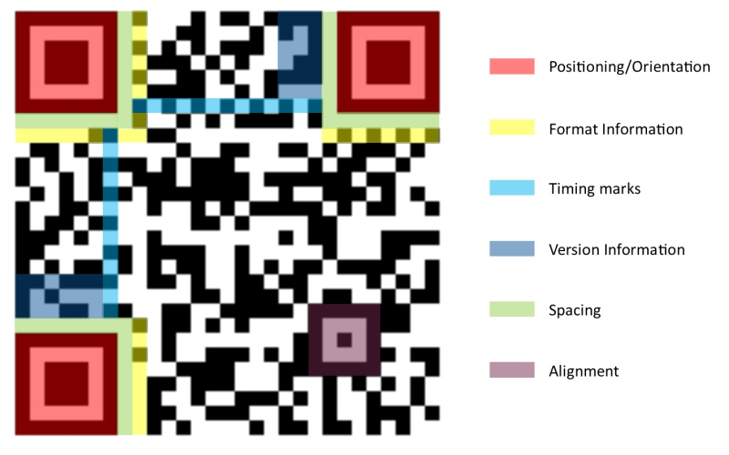
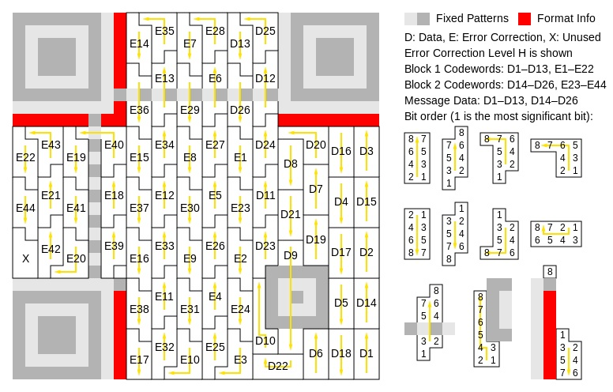
QR Codes: Reading Data
http://datagenetics.com/blog/november12013/index.html

Slide 34
Coming up...
Interpolation
General Image Warping

